Slide 1
The Urinary System: Fluid and Electrolyte Balance
19a

Slide 2
Chapter Outline
19.1 The Concept of Balance
19.2 Water Balance
19.3 Sodium Balance
19.4 Potassium Balance
19.5 Calcium Balance
19.6 Interactions Between Fluid and Electrolyte Regulation
19.7 Acid-Base Balance

Slide 3
19.1 The Concept of Balance
To maintain homeostasis, what comes in the body must eventually be used or excreted
To be in balance
Input + production = utilization + output

Slide 4
Factors Affecting the Plasma Composition
Kidneys regulate solute and water content, which also determines volume
Regulate acid-base balance
Composition is also affected by exchange between different compartments of body
Cells
Connective tissue
Gastrointestinal tract
Sweating
Respiration

Slide 5
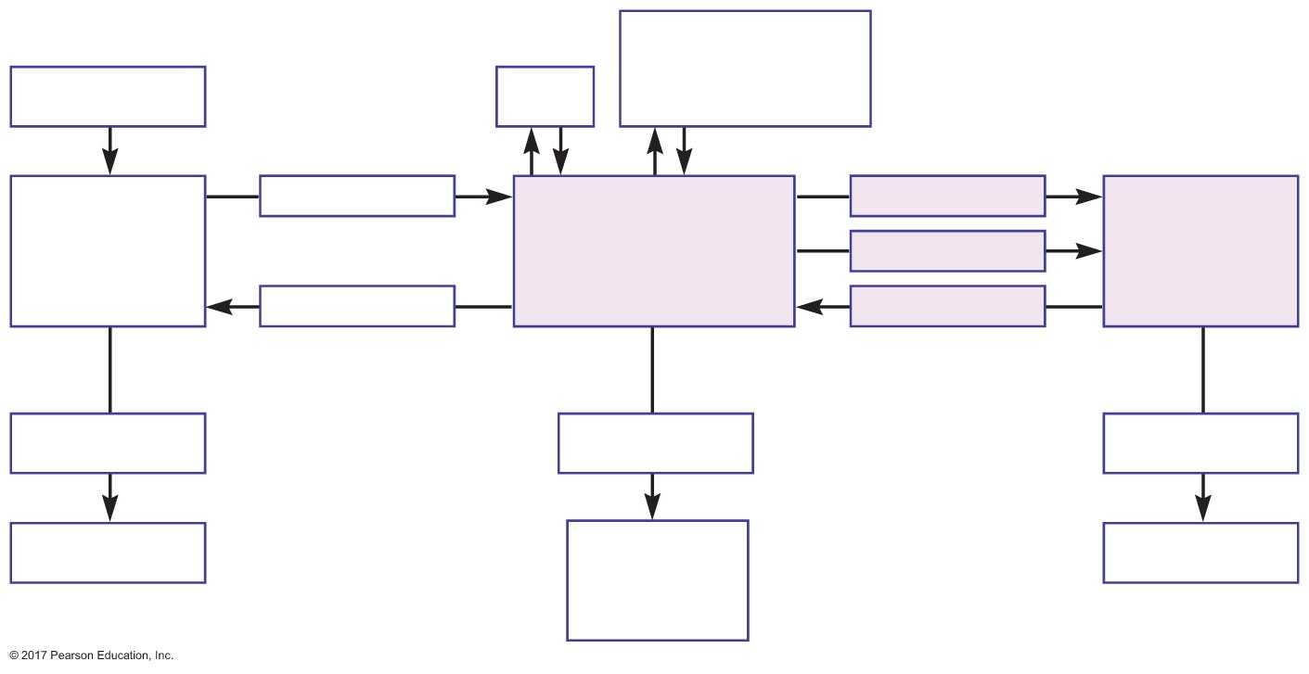
Figure 19.1 Material exchanges affecting plasma content.
Extracellular
connective tissue
(including bone)
Ingestion
Cells
Absorption
Filtration
Lumen of
digestive
tract
Plasma and
interstitial ﬂuid
(extracellular ﬂuid)
Lumen of
renal
tubules
Secretion
Secretion
Reabsorption
Excretion
(Minimal)
Other losses
Excretion
Feces
Sweating,
hemorrhage,
respiration
Urine

Slide 6
Solute and Water Balance
Balance
Solutes and water enter and exit plasma at the same rate
Quantity stays the same
Positive balance
Solute or water enters plasma faster than it exits
Quantity increases
Negative balance
Solute or water exits plasma faster than it enters
Quantity decreases

Slide 7
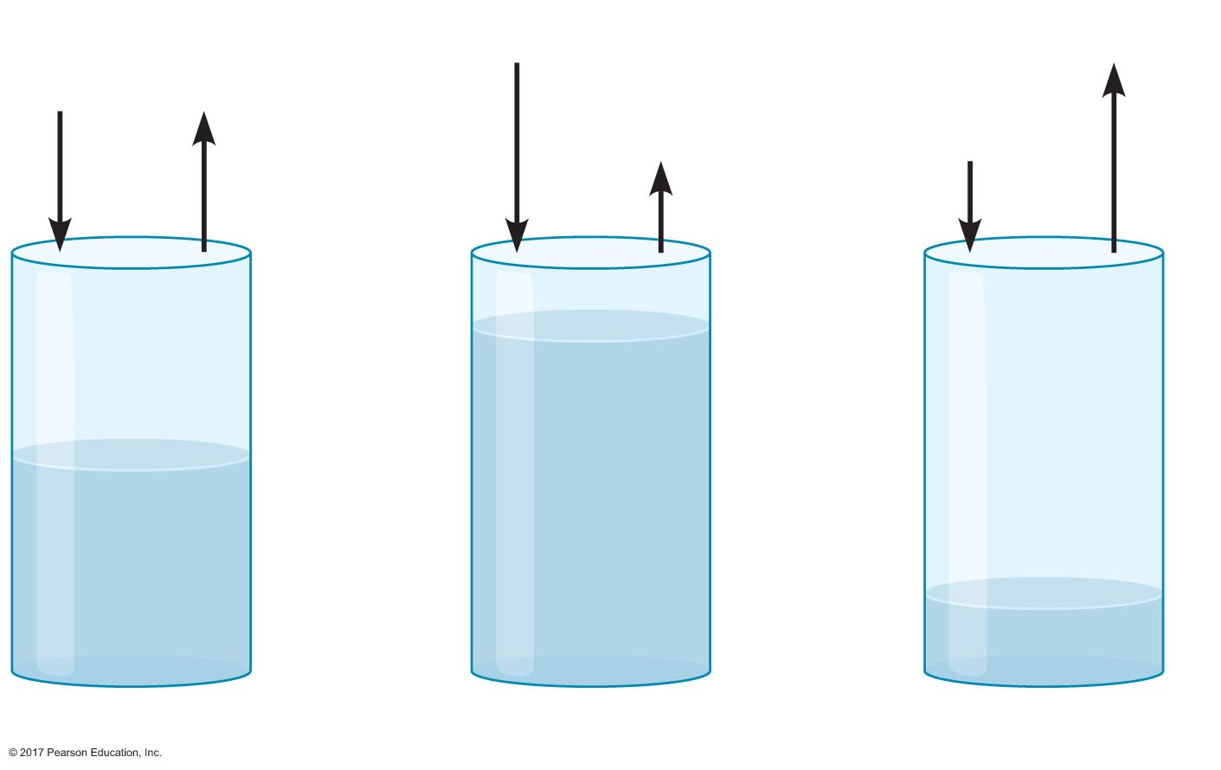
Figure 19.2 The concept of balance.
Input
Output
Input
Output
Output
Input
Increase
No change
Decrease
Balance
Positive balance
Negative balance

Slide 8
Solute and Water Balance
Cells in late distal tubules and collecting ducts that regulate balance
Principal cells
Water
Electrolytes
Intercalated cells
Acid-base balance

Slide 9
19.2 Water Balance
Osmolarity and the movement of water
Water reabsorption in the proximal tubule
Establishment of the medullary osmotic gradient
Role of the medullary osmotic gradient in water reabsorption in the distal tubule and collecting duct

Slide 10
Water Balance
Water intake + metabolically produced = water output + water used
Intake
Gastrointestinal tract
Metabolism
Output
Insensible loss
Sweating
Gastrointestinal tract
Kidneys

Slide 11
Water Balance
Normovolemia = normal blood volume
Hypervolemia = high blood volume due to positive water balance
Hypovolemia = low blood volume due to negative water balance

Slide 12
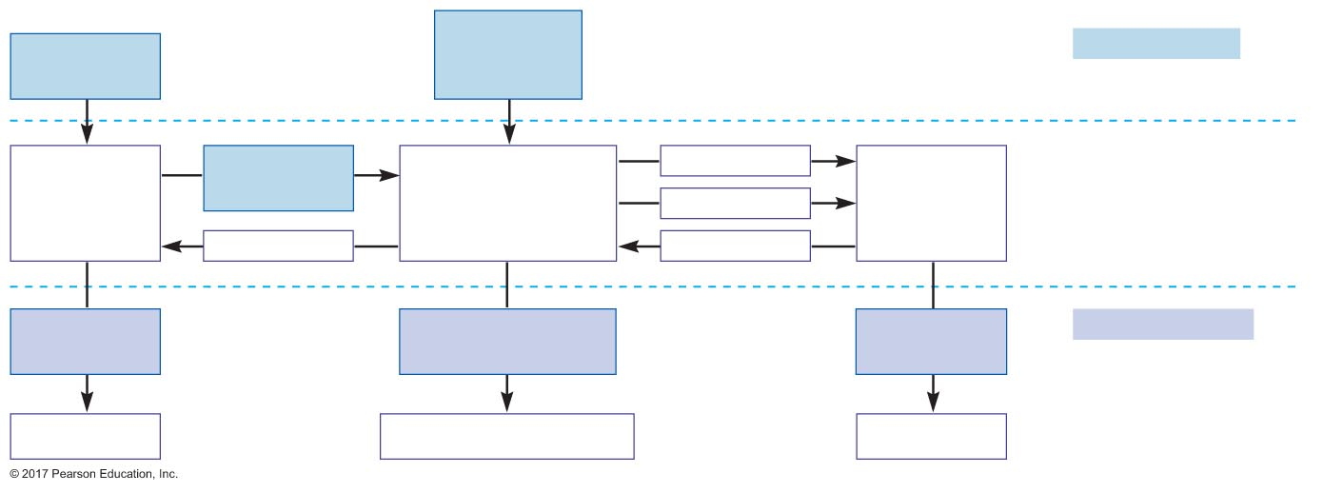
Figure 19.3 Factors affecting water balance.
Cellular
metabolism
0.3 L/day
Water inputs =
Ingestion
2.2 L/day
2.2 L/day + 0.3 L/day = 2.5 L/day
Absorption
Filtration
Digestive
tract
Total body water
42 L/day
Secretion
Renal
tubules
Secretion
Reabsorption
Excretion
0.1 L/day
Other losses
0.9 L/day
Excretion
1.5 L/day
Water outputs =
0.1 L/day
+ 0.9 L/day
Feces
Insensible loss, sweating
Urine
+ 1.5 L/day
= 2.5 L/day

Slide 13
Osmolarity and the Movement of Water
Osmosis
Water diffuses down the concentration gradient
Water moves from area of low solute concentration to area of high solute concentration
Water reabsorption follows solute reabsorption

Slide 14
Osmolarity and the Movement of Water
Osmolarity of body fluids = 300 mOsm (300 milliosmoles of solute per liter of plasma)
No osmotic force for water to move between fluid compartments
Kidneys compensate for changes in osmolarity of extracellular fluid by regulating water reabsorption
Water reabsorption is a passive process
Based on osmotic gradient

Slide 15
Osmolarity and the Movement of Water
Water reabsorption
Proximal tubules
70% of filtered water is reabsorbed
Not regulated
Distal tubules and collecting ducts
Most remaining water is reabsorbed
Regulated by ADH (vasopressin)

Slide 16
Water Reabsorption in the Proximal Tubule
Water reabsorption follows solute reabsorption
Primary solute = sodium
Na⁺ is actively transported across the basolateral membrane; establishes an osmotic gradient for water reabsorption

Slide 17
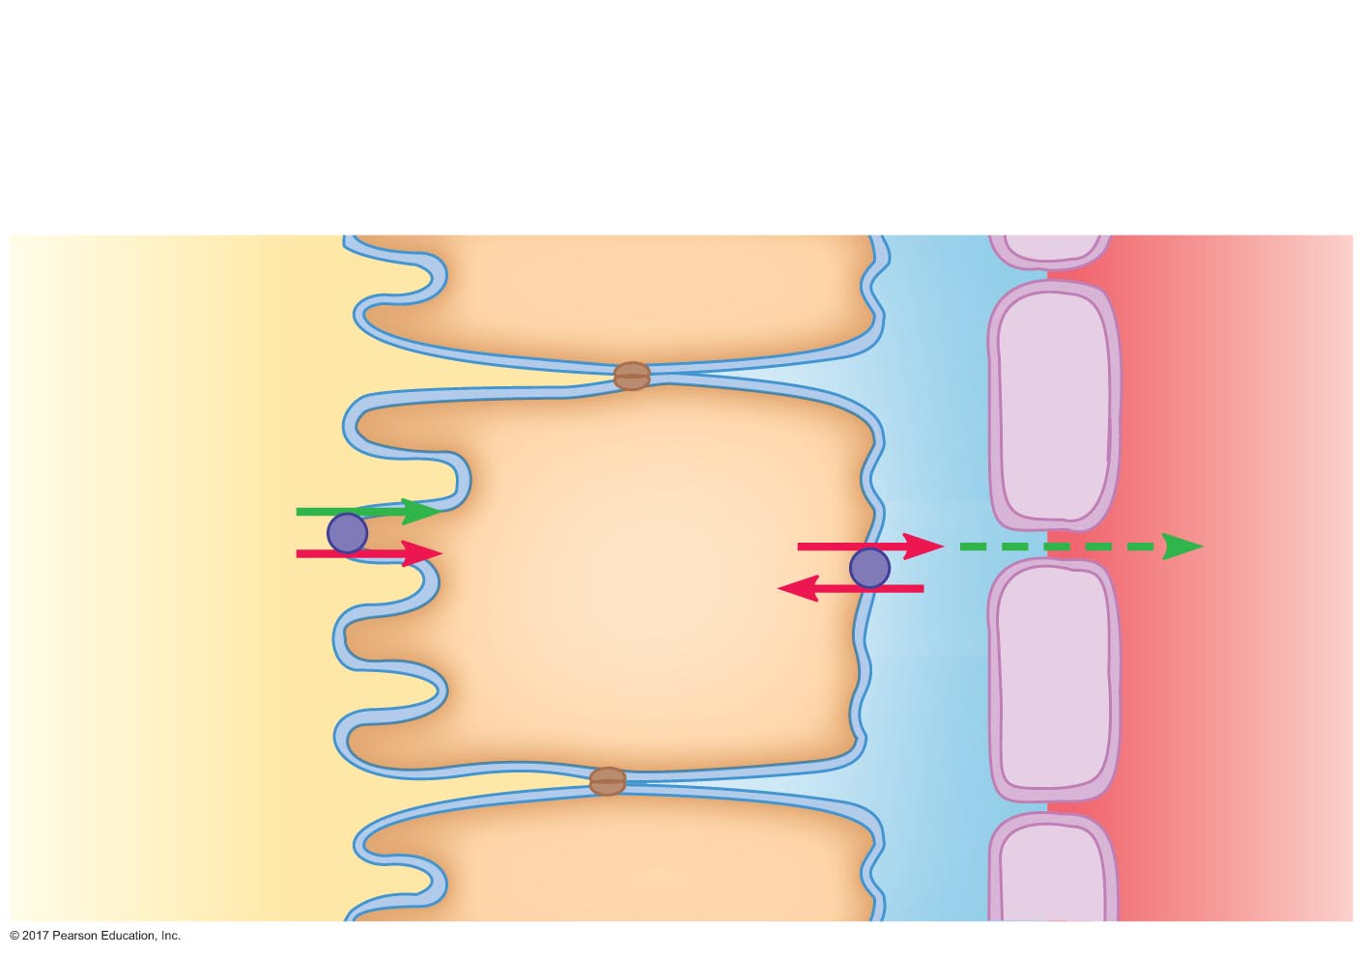
Figure 19.4 Mechanism of sodium reabsorption in the proximal tubule.
Peritubular ﬂuid
Apical
membrane
Renal tubule
epithelial cell
Basolateral
membrane
Capillary
endothelial cell
Tubular ﬂuid
Plasma
Na⁺
Glucose
Na⁺
Na⁺
K⁺

Slide 18
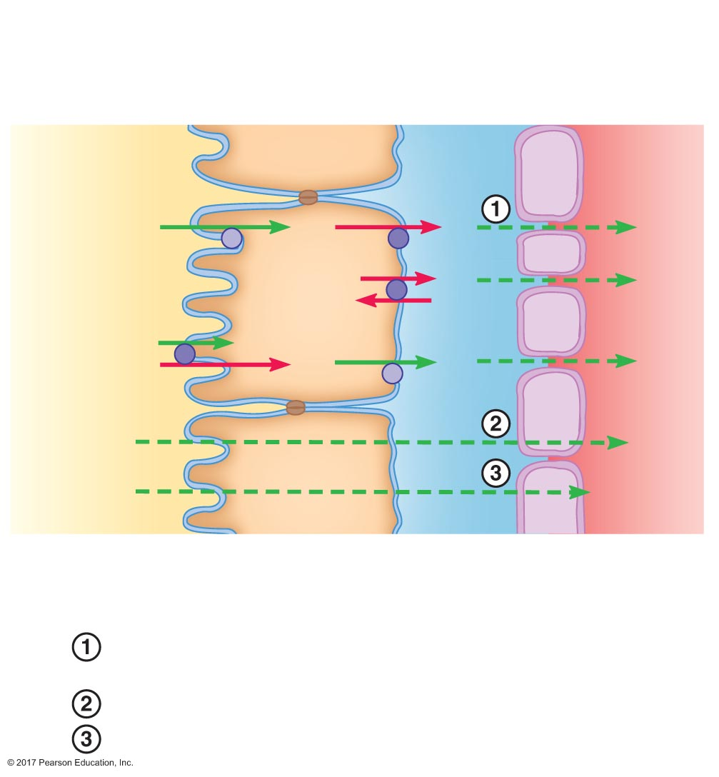
Figure 19.5 Mechanism of water reabsorption.
Slide 1
Peritubular ﬂuid
Apical
membrane
Tubule
epithelial
cell
Basolateral
membrane
Capillary
endothelial cell
Tubular ﬂuid
Plasma
X
X
X
Na⁺
Na⁺
K⁺
Na⁺
Y
Y
Y
H₂O
H₂O
Permeating
solute
Permeating
solute
Steps for water and urea reabsorption:
Solutes (Na⁺, X, Y) are actively reabsorbed, increasing the
osmolarity of peritubular ﬂuid and plasma.
Water is reabsorbed by osmosis.
Urea (permeating solute) is reabsorbed passively.

Slide 19
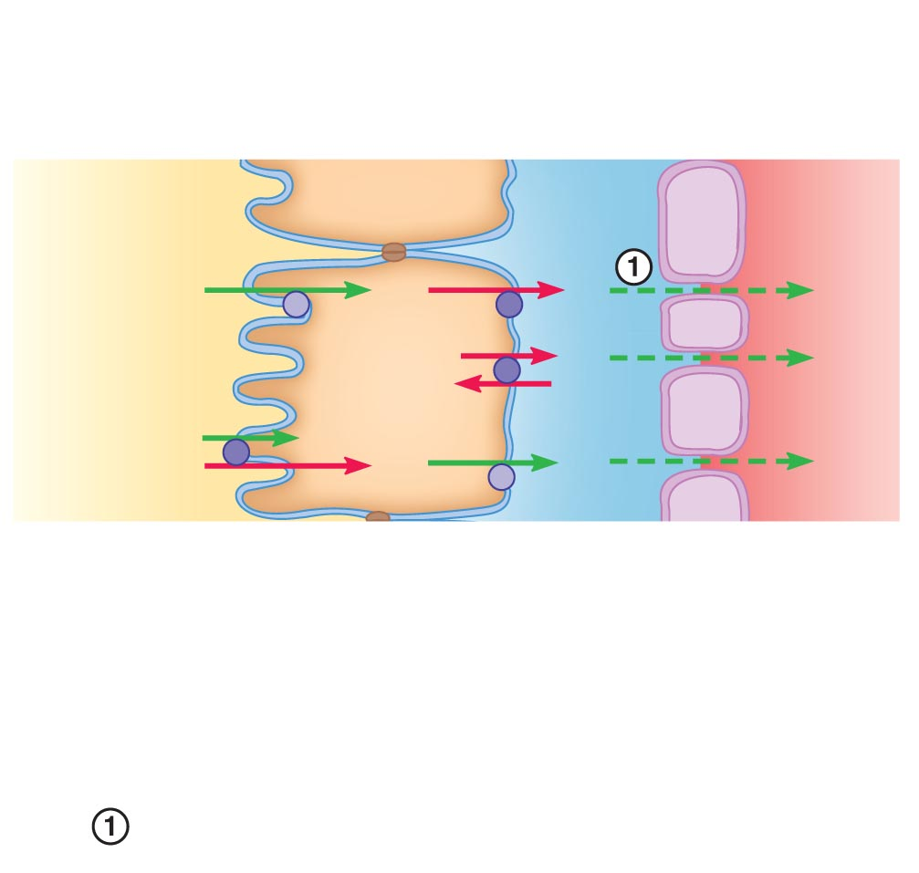
Figure 19.5 Mechanism of water reabsorption.
Slide 2
Peritubular ﬂuid
Apical
membrane
Tubule
epithelial
cell
Basolateral
membrane
Capillary
endothelial cell
Tubular ﬂuid
Plasma
X
X
X
Na⁺
Na⁺
K⁺
Na⁺
Y
Y
Y
Steps for water and urea reabsorption:
Solutes (Na⁺, X, Y) are actively reabsorbed, increasing the
osmolarity of peritubular ﬂuid and plasma.

Slide 20
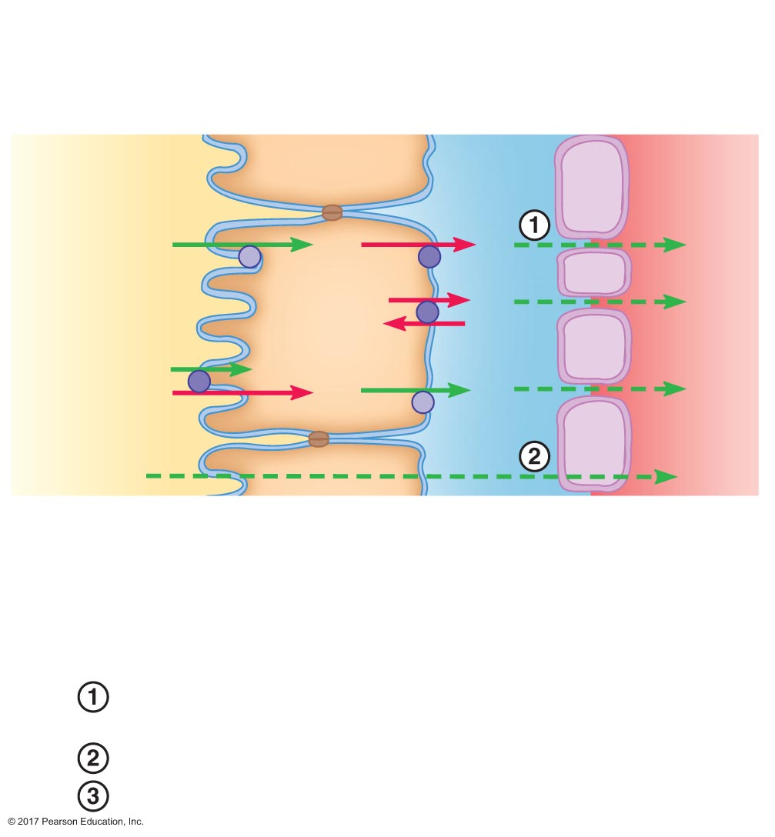
Figure 19.5 Mechanism of water reabsorption.
Slide 3
Peritubular ﬂuid
Apical
membrane
Tubule
epithelial
cell
Basolateral
membrane
Capillary
endothelial cell
Tubular ﬂuid
Plasma
X
X
X
Na⁺
Na⁺
K⁺
Na⁺
Y
Y
Y
H₂O
H₂O
Steps for water and urea reabsorption:
Solutes (Na⁺, X, Y) are actively reabsorbed, increasing the
osmolarity of peritubular ﬂuid and plasma.
Water is reabsorbed by osmosis.

Slide 21
Figure 19.5 Mechanism of water reabsorption.
Slide 4
Peritubular ﬂuid
Apical
membrane
Tubule
epithelial
cell
Basolateral
membrane
Capillary
endothelial cell
Tubular ﬂuid
Plasma
X
X
X
Na⁺
Na⁺
K⁺
Na⁺
Y
Y
Y
H₂O
H₂O
Permeating
solute
Permeating
solute
Steps for water and urea reabsorption:
Solutes (Na⁺, X, Y) are actively reabsorbed, increasing the
osmolarity of peritubular ﬂuid and plasma.
Water is reabsorbed by osmosis.
Urea (permeating solute) is reabsorbed passively.

Slide 22
Establishment of the Medullary Osmotic Gradient
Osmolarity of interstitial fluid of renal medulla varies with depth
Lower osmolarity near cortex
Greater osmolarity near renal pelvis
Gradient is critical to water reabsorption

Slide 23
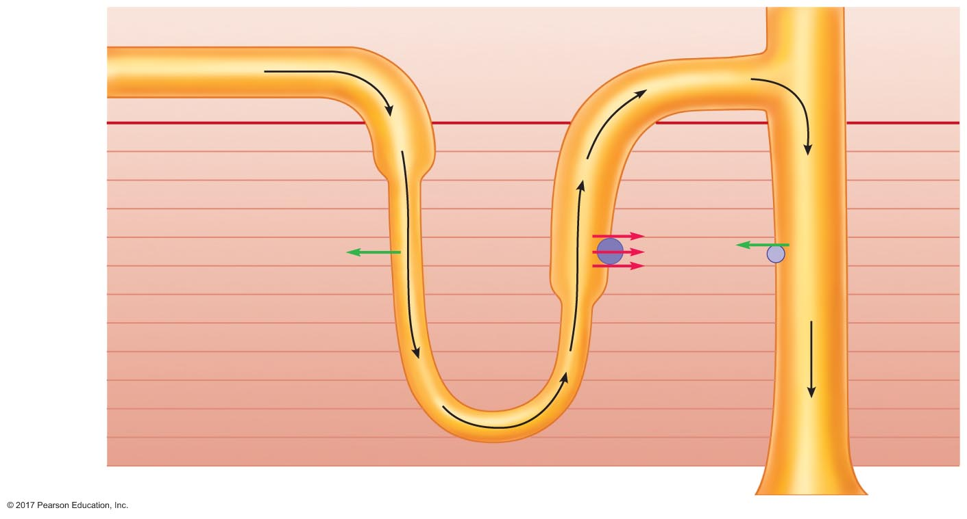
Figure 19.6 The medullary osmotic gradient.
Proximal tubule
Direction of
ﬂuid ﬂow
Distal tubule
Collecting
duct
Tubular ﬂuid
Peritubular
ﬂuid
300
Cortex
300
Medulla
400
500
600
K⁺
700
Water
Na⁺
Urea
800
Cl–
Medullary
osmotic
gradient
(mOsm)
Thick
ascending limb
900
Descending limb
– Permeable to water
– No Na⁺, K⁺, Cl–
transport
1000
– Impermeable to
water
– Na⁺, K⁺, Cl–
cotransporter
1100
1200
1300
1400
Loop of Henle
Renal pelvis

Slide 24
Establishment of the Medullary Osmotic Gradient
Osmotic gradient is established by the countercurrent multiplier
Dependent on loop of Henle
Ascending limb
Impermeable to water
Active transport of Na⁺, Cl–, and K⁺
Descending limb
Permeable to water
No transport of Na⁺, Cl–, or K⁺

Slide 25
Establishment of the Medullary Osmotic Gradient
Result of countercurrent multiplier
Fluid in proximal tubule = 300 mOsm
Fluid in descending limb: osmolarity increases as it descends
Osmolarity = interstitial fluid
Osmolarity > descending limb
Fluid in ascending limb: osmolarity decreases as it ascends
Osmolarity < interstitial fluid
Osmolarity < descending limb

Slide 26
Establishment of the Medullary Osmotic Gradient
Result of countercurrent multiplier
Fluid in distal tubule = 100 mOsm
Cortical interstitial fluid = 300 mOsm
Medullary interstitial fluid: increases from cortex to renal pelvis

Slide 27
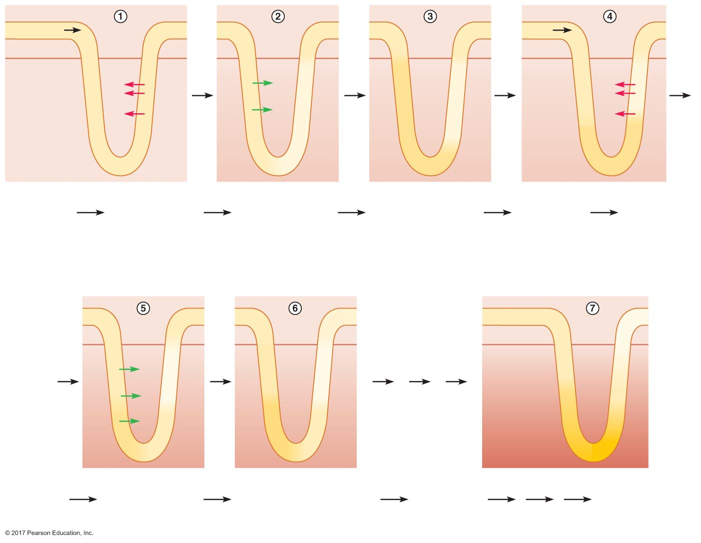
Figure 19.7 How the countercurrent multiplier establishes the medullary osmotic gradient.
Slide 1
Peritubular ﬂuid
Tubular ﬂuid
300
300
300
300
300
300
300
300
300
Fluid
300
300
300
Cortex
Medulla
300
300
300
300
400
200
400
400
200
300
400
200
Na ⁺
H₂O
Na ⁺
300
Cl –
300
300
400
200
400
400
200
Cl –
No osmotic
gradient
(mOsm)
300
H₂O
300
400
200
K⁺
300
400
200
400
400
200
K⁺
300
300
300
400
400
400
300
300
300
300
400
200
400
400
200
400
400
400
Fluid
enters
tubule
Active transport
of Na⁺, Cl–, K⁺ ions
into medullary
interstitial ﬂuid
increases
osmolarity
Water moves
out of descending
limb by osmosis
Iso-osmotic state in
descending limb;
osmotic difference
between descending
and ascending limbs
More ﬂuid
enters tubule,
pushing ﬂuid
through by
bulk ﬂow
Active
transport of
Na⁺, Cl–, K⁺
ions into
medullary
interstitial
ﬂuid increases
osmolarity
300
300
200
300
300
200
300
300
100
300
350
150
350
350
150
300
300
100
H₂O
Osmotic
gradient
established
(mOsm)
500
500
300
300
350
150
350
350
150
H₂O
900
900
700
400
500
300
500
500
300
H₂O
1200
1200
1100
400
500
300
500
500
300
1400
1400
Water moves
out of descending
limb by osmosis
Iso-osmotic state in descending
limb; osmotic difference
between descending and
ascending limbs
More water
enters tubule
and process
continues
System
is in steady
state

Slide 28
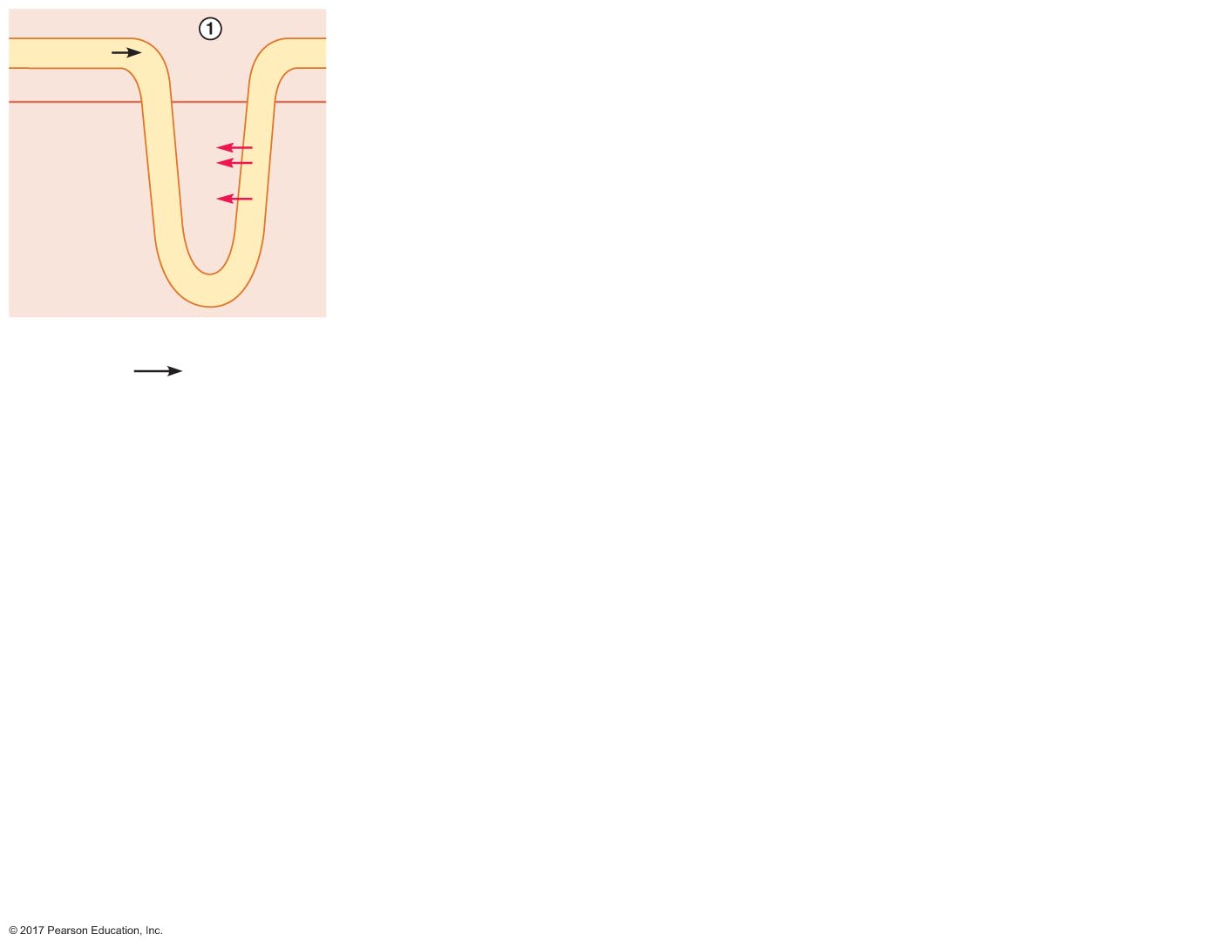
Figure 19.7 How the countercurrent multiplier establishes the medullary osmotic gradient.
Slide 2
Peritubular ﬂuid
Tubular ﬂuid
300
300
300
Cortex
Medulla
300
300
300
Na ⁺
300
Cl –
300
No osmotic
gradient
(mOsm)
300
K⁺
300
300
300
300
300
300
Fluid
enters
tubule
Active transport
of Na⁺, Cl–, K⁺ ions
into medullary
interstitial ﬂuid
increases
osmolarity

Slide 29
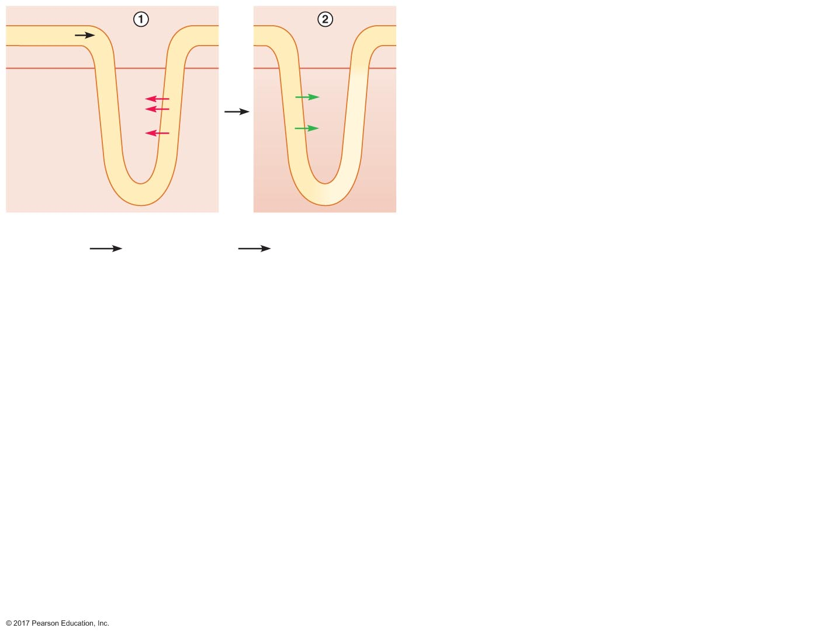
Figure 19.7 How the countercurrent multiplier establishes the medullary osmotic gradient.
Slide 3
Peritubular ﬂuid
Tubular ﬂuid
300
300
300
300
300
300
Cortex
Medulla
300
300
300
300
400
200
Na ⁺
H₂O
300
Cl –
300
300
400
200
No osmotic
gradient
(mOsm)
300
H₂O
K⁺
300
400
200
300
300
300
300
300
300
300
400
200
Fluid
enters
tubule
Active transport
of Na⁺, Cl–, K⁺ ions
into medullary
interstitial ﬂuid
increases
osmolarity
Water moves
out of descending
limb by osmosis

Slide 30
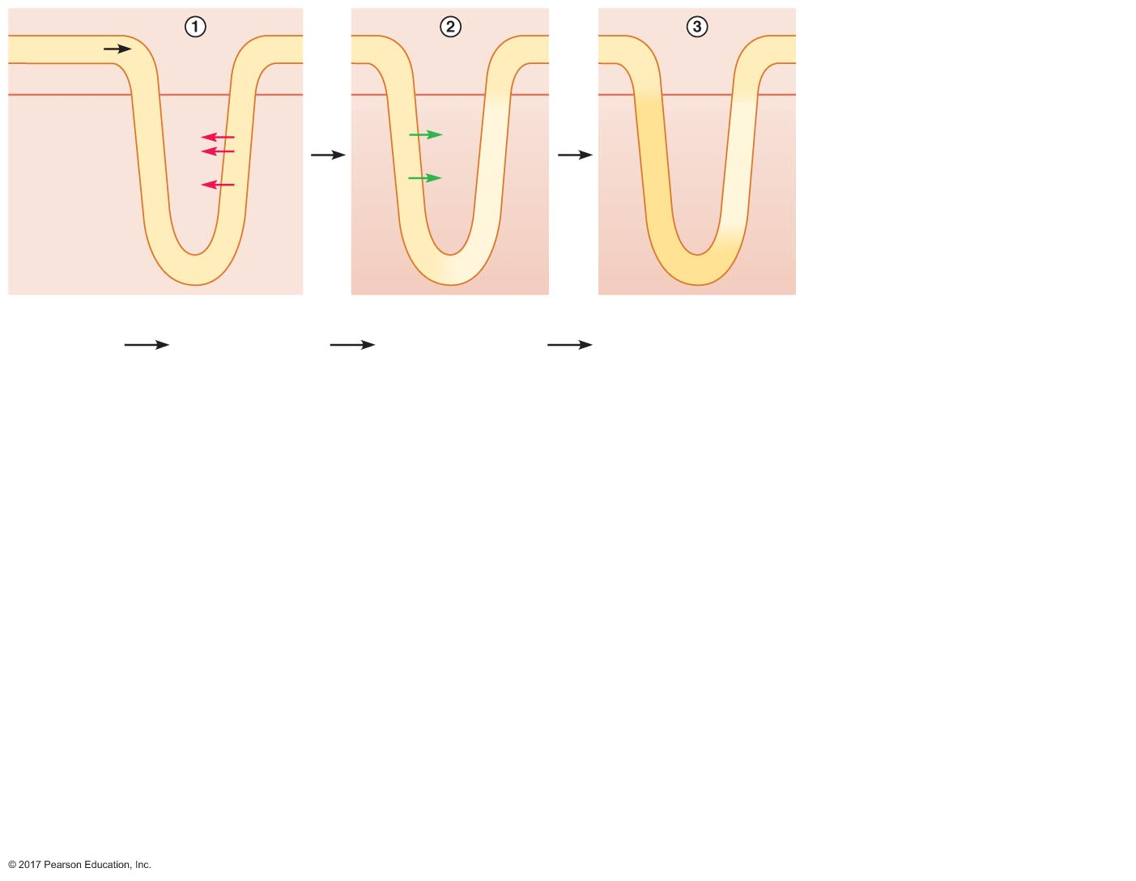
Figure 19.7 How the countercurrent multiplier establishes the medullary osmotic gradient.
Slide 4
Peritubular ﬂuid
Tubular ﬂuid
300
300
300
300
300
300
300
300
300
Cortex
Medulla
300
300
300
300
400
200
400
400
200
Na ⁺
H₂O
300
Cl –
300
300
400
200
400
400
200
No osmotic
gradient
(mOsm)
300
H₂O
K⁺
300
400
200
400
400
200
300
300
300
300
300
300
300
400
200
400
400
200
Fluid
enters
tubule
Active transport
of Na⁺, Cl–, K⁺ ions
into medullary
interstitial ﬂuid
increases
osmolarity
Water moves
out of descending
limb by osmosis
Iso-osmotic state in
descending limb;
osmotic difference
between descending
and ascending limbs

Slide 31
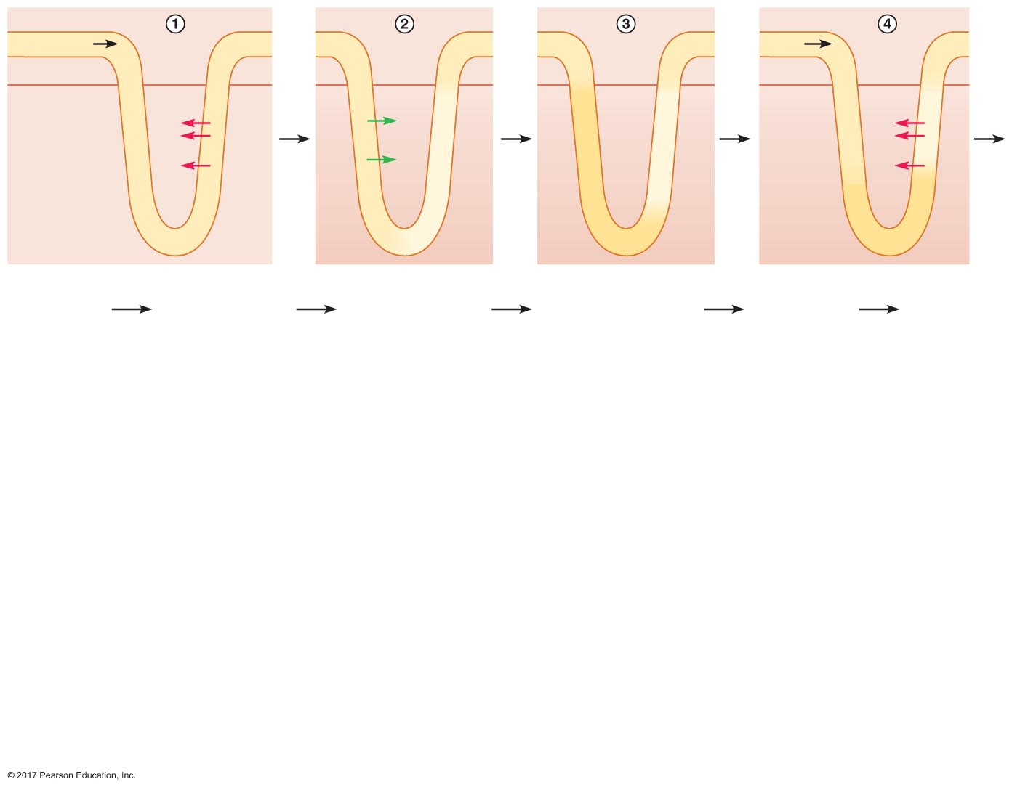
Figure 19.7 How the countercurrent multiplier establishes the medullary osmotic gradient.
Slide 5
Peritubular ﬂuid
Tubular ﬂuid
300
300
300
300
300
300
300
300
300
Fluid
300
300
300
Cortex
Medulla
300
300
300
300
400
200
400
400
200
300
400
200
Na ⁺
H₂O
Na ⁺
300
Cl –
300
300
400
200
400
400
200
Cl –
No osmotic
gradient
(mOsm)
300
H₂O
300
400
200
K⁺
300
400
200
400
400
200
K⁺
300
300
300
400
400
400
300
300
300
300
400
200
400
400
200
400
400
400
Fluid
enters
tubule
Active transport
of Na⁺, Cl–, K⁺ ions
into medullary
interstitial ﬂuid
increases
osmolarity
Water moves
out of descending
limb by osmosis
Iso-osmotic state in
descending limb;
osmotic difference
between descending
and ascending limbs
More ﬂuid
enters tubule,
pushing ﬂuid
through by
bulk ﬂow
Active
transport of
Na⁺, Cl–, K⁺
ions into
medullary
interstitial
ﬂuid increases
osmolarity

Slide 32
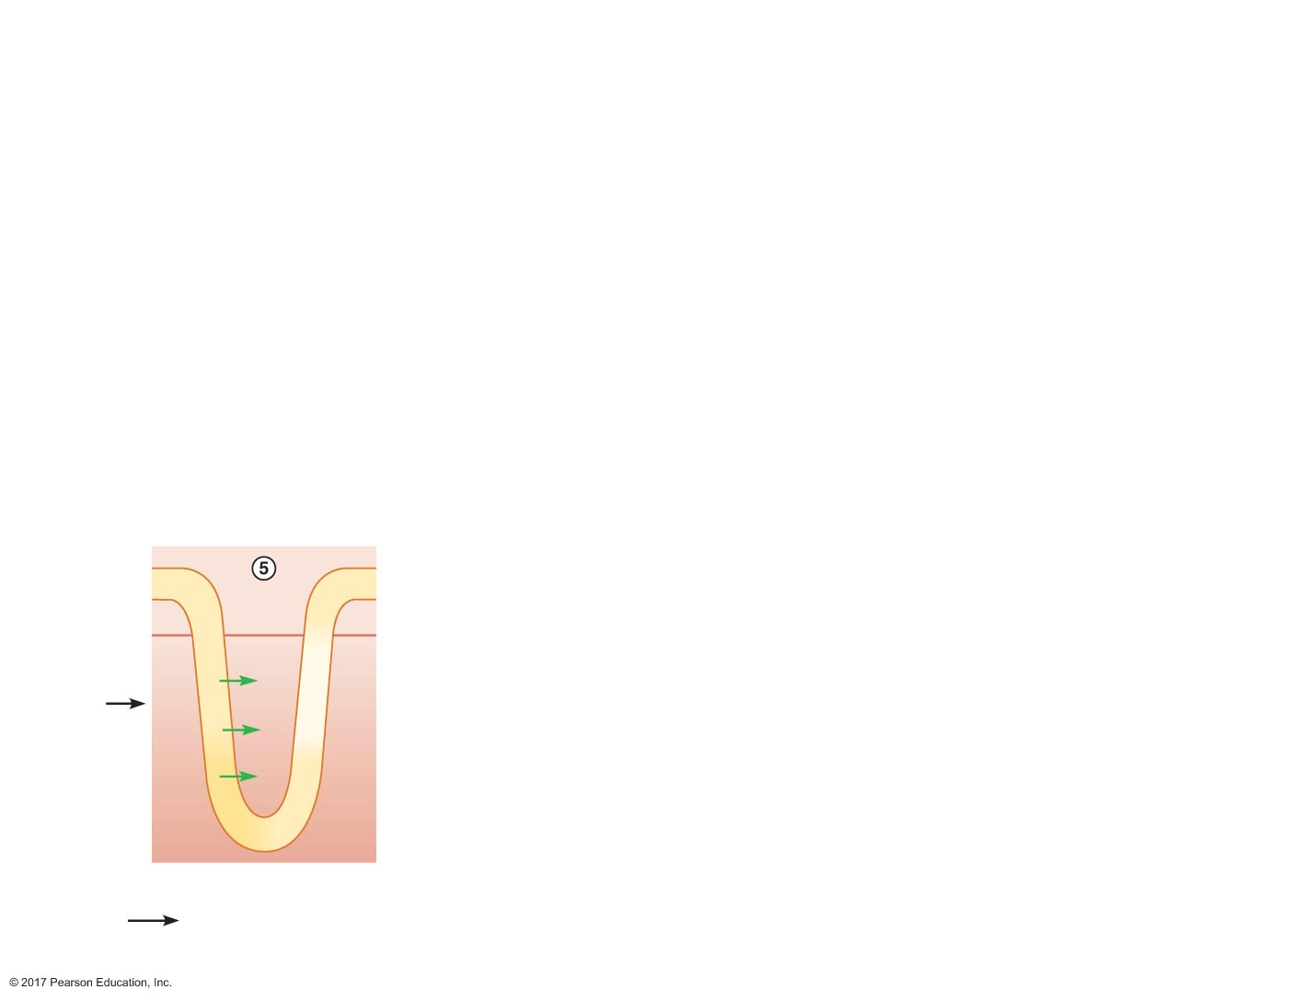
Figure 19.7 How the countercurrent multiplier establishes the medullary osmotic gradient.
Slide 6
300
300
200
300
350
150
H₂O
300
350
150
H₂O
400
500
300
H₂O
400
500
300
Water moves
out of descending
limb by osmosis

Slide 33
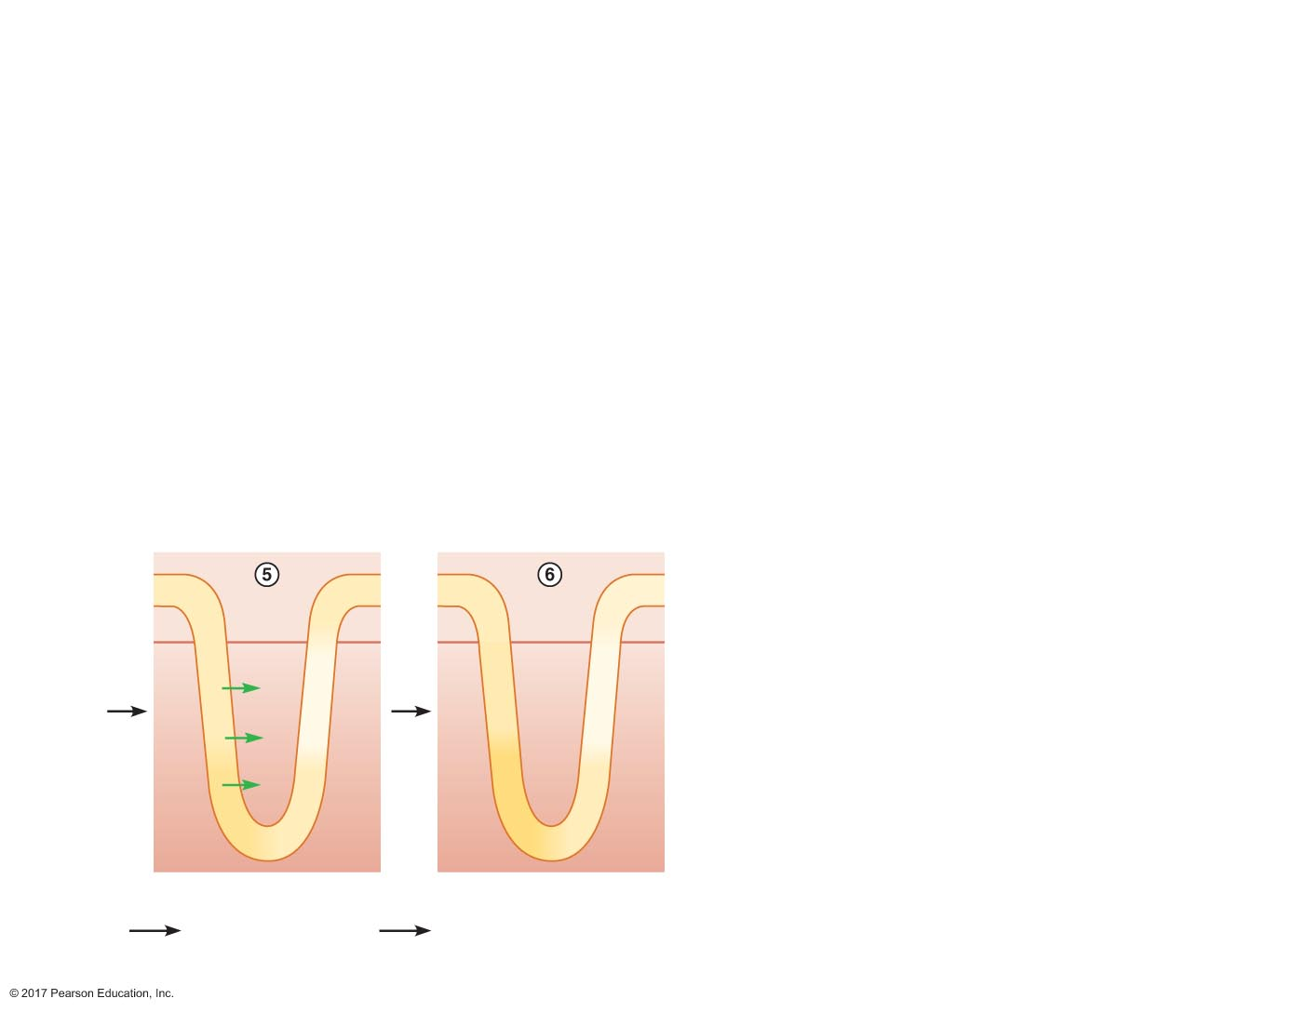
Figure 19.7 How the countercurrent multiplier establishes the medullary osmotic gradient.
Slide 7
300
300
200
300
300
200
300
350
150
350
350
150
H₂O
300
350
150
350
350
150
H₂O
400
500
300
500
500
300
H₂O
400
500
300
500
500
300
Water moves
out of descending
limb by osmosis
Iso-osmotic state in descending
limb; osmotic difference
between descending and
ascending limbs

Slide 34
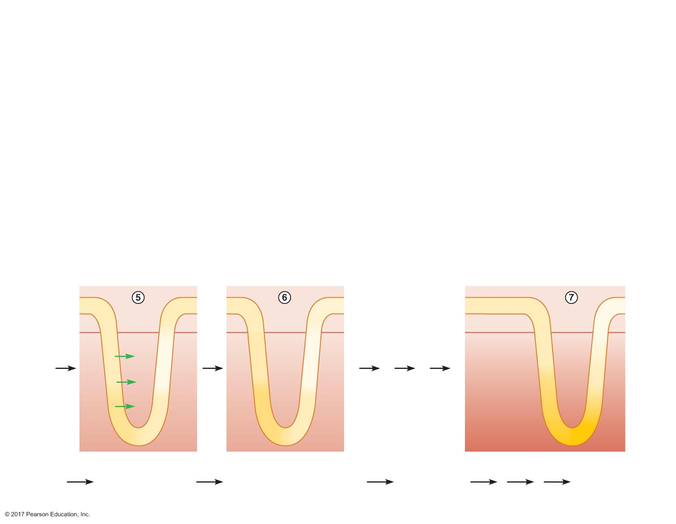
Figure 19.7 How the countercurrent multiplier establishes the medullary osmotic gradient.
Slide 8
300
300
200
300
300
200
300
300
100
300
350
150
350
350
150
300
300
100
H₂O
Osmotic
gradient
established
(mOsm)
500
500
300
300
350
150
350
350
150
H₂O
900
900
700
400
500
300
500
500
300
H₂O
1200
1200
1100
400
500
300
500
500
300
1400
1400
Water moves
out of descending
limb by osmosis
Iso-osmotic state in descending
limb; osmotic difference
between descending and
ascending limbs
More water
enters tubule
and process
continues
System
is in steady
state

Slide 35
Figure 19.7 How the countercurrent multiplier establishes the medullary osmotic gradient.
Slide 9
Peritubular ﬂuid
Tubular ﬂuid
300
300
300
300
300
300
300
300
300
Fluid
300
300
300
Cortex
Medulla
300
300
300
300
400
200
400
400
200
300
400
200
Na ⁺
H₂O
Na ⁺
300
Cl –
300
300
400
200
400
400
200
Cl –
No osmotic
gradient
(mOsm)
300
H₂O
300
400
200
K⁺
300
400
200
400
400
200
K⁺
300
300
300
400
400
400
300
300
300
300
400
200
400
400
200
400
400
400
Fluid
enters
tubule
Active transport
of Na⁺, Cl–, K⁺ ions
into medullary
interstitial ﬂuid
increases
osmolarity
Water moves
out of descending
limb by osmosis
Iso-osmotic state in
descending limb;
osmotic difference
between descending
and ascending limbs
More ﬂuid
enters tubule,
pushing ﬂuid
through by
bulk ﬂow
Active
transport of
Na⁺, Cl–, K⁺
ions into
medullary
interstitial
ﬂuid increases
osmolarity
300
300
200
300
300
200
300
300
100
300
350
150
350
350
150
300
300
100
H₂O
Osmotic
gradient
established
(mOsm)
500
500
300
300
350
150
350
350
150
H₂O
900
900
700
400
500
300
500
500
300
H₂O
1200
1200
1100
400
500
300
500
500
300
1400
1400
Water moves
out of descending
limb by osmosis
Iso-osmotic state in descending
limb; osmotic difference
between descending and
ascending limbs
More water
enters tubule
and process
continues
System
is in steady
state

Slide 36
Establishment of the Medullary Osmotic Gradient
Role of urea in the medullary osmotic gradient
Urea
Generated by liver
Nitrogen elimination
Extremely water soluble
Requires urea transporters: UTA, UTB, and UTC
Transport of urea through UTA from filtrate to peritubular fluid contributes approximately 40% of the osmolarity of the gradient

Slide 37
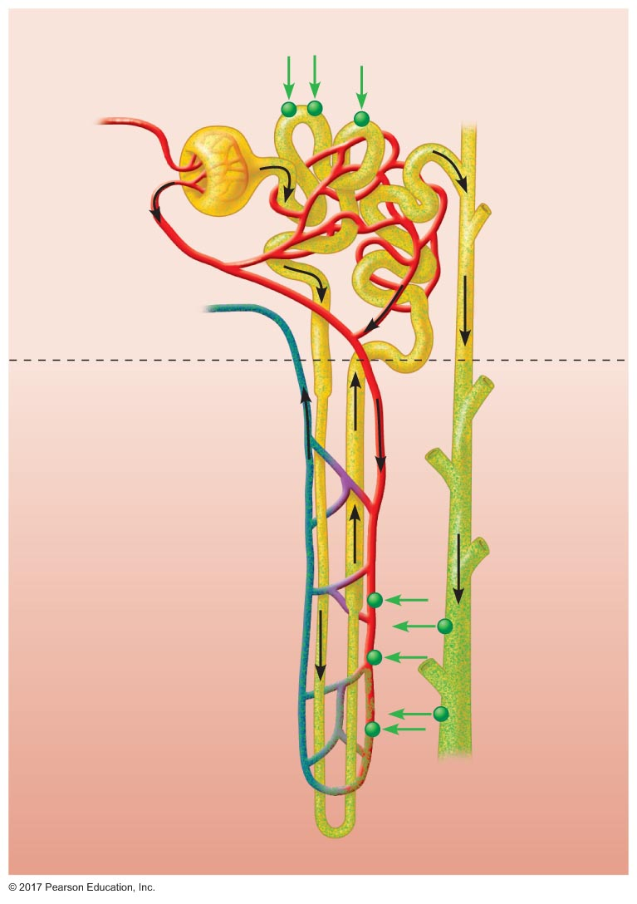
Figure 19.8 Contribution of urea to the medullary osmotic gradient.
Bowman's
capsule
Glomerulus
UT-C
Proximal tubule
Afferent
arteriole
Peritubular
capillaries
Efferent
arteriole
Distal
tubule
Branch of
renal vein
Cortex
Medulla
Descending
limb
Collecting
duct
Loop of
Henle
Ascending
limb
Urea
UT-A
Vasa
recta
UT-B

Slide 38
Establishment of the Medullary Osmotic Gradient
Role of the vasa recta
Anatomical arrangement of vasa recta capillaries prevents the diffusion of water and solutes from dissipating the medullary osmotic gradient
Descending limb of vasa recta (300 mOsm)
As it descends, water leaves capillaries by osmosis and solutes enter by diffusion
Ascending limb of vasa recta (325 mOsm)
Water moves into plasma and solutes move into interstitial fluid
Osmolarity is higher due to the lack of urea transporters

Slide 39
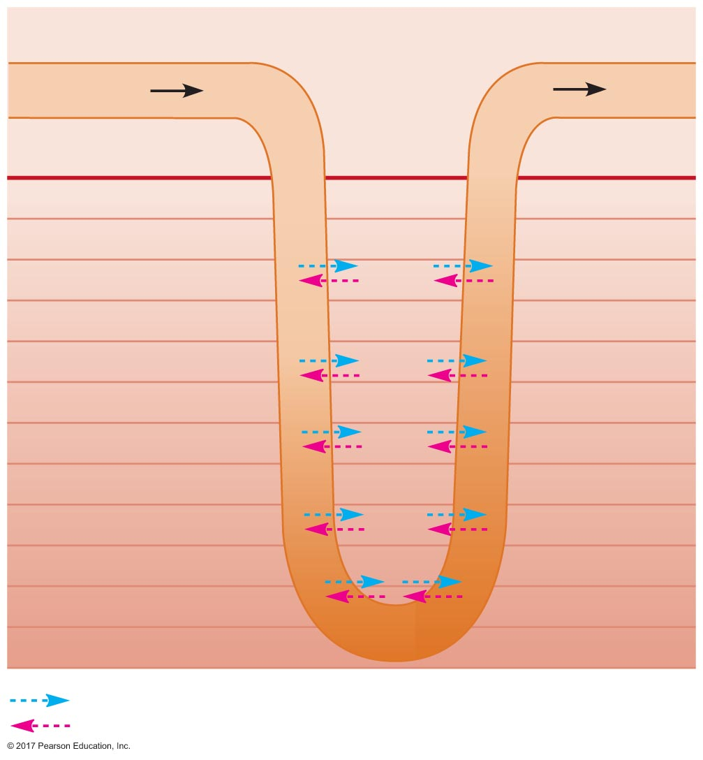
Figure 19.9 How the vasa recta prevents the dissipation of the medullary osmotic gradient.
Peritubular ﬂuid
Blood
ﬂow
Vasa recta
Blood
ﬂow
300
325
300
Cortex
Medulla
300
300
375
400
425
400
575
600
625
600
Osmotic
gradient
in vasa
recta
(mOsm)
775
800
825
800
975
1000
1025
1000
1175
1200
1225
1200
1375
1375
1400
Water movement
Solute ﬂow

Slide 40
Role of the Medullary Osmotic Gradient in Water Reabsorption in the Distal Tubule and Collecting Duct
70% water reabsorbed in proximal tubule
Not regulated
20% reabsorbed in distal tubule
Regulated by ADH
10% reabsorbed in collecting ducts
Regulated by ADH

Slide 41
Role of the Medullary Osmotic Gradient in Water Reabsorption in the Distal Tubule and Collecting Duct
Dependent on osmotic gradient established by countercurrent multiplier
Dependent on epithelium permeability to water
Water permeability dependent on water channels
Aquaporin-3: present in basolateral membrane always
Aquaporin-2: present in apical membrane only when ADH present in blood

Slide 42
Role of the Medullary Osmotic Gradient in Water Reabsorption in the Distal Tubule and Collecting Duct
When membrane of late distal tubule and collecting duct is impermeable to water
Water cannot leave the tubules
No water reabsorption
More water is excreted in urine

Slide 43
Role of the Medullary Osmotic Gradient in Water Reabsorption in the Distal Tubule and Collecting Duct
ADH stimulates the insertion of water channels (aquaporin-2) into apical membrane
Water is reabsorbed by osmosis
Maximum urine concentration is 1400 mOsm
Maximum amount of water reabsorbed depends on length of loop of Henle

Slide 44
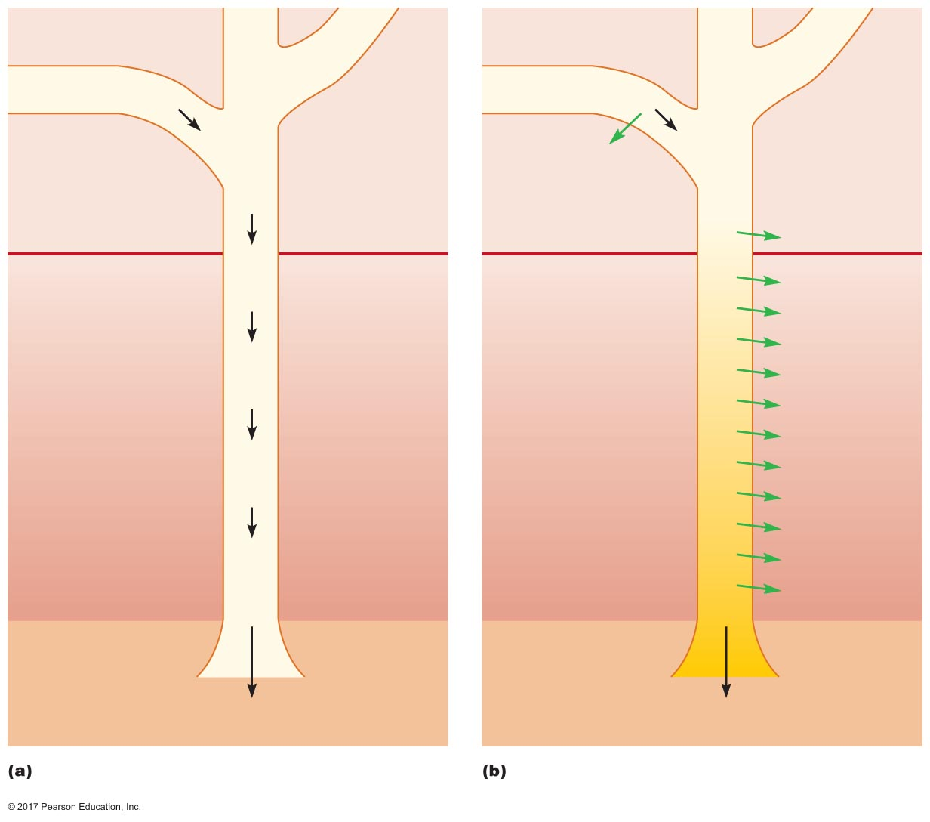
Figure 19.10 Water reabsorption across the late distal tubule and collecting duct.
Late distal tubule
(impermeable to H₂O)
Late distal tubule
(permeable to H₂O)
Tubular
ﬂuid
100
Tubular
ﬂuid
100
Peritubular
ﬂuid
Peritubular
ﬂuid
H₂O
Collecting duct
(permeable
to H₂O)
100
Collecting duct
(impermeable
to H₂O)
Cortex
300
300
H₂O
Medulla
300
100
300
300
H₂O
400
400
400
H₂O
500
500
H₂O
600
600
600
H₂O
100
700
700
800
800
800
H₂O
900
900
H₂O
1000
100
1000
1000
H₂O
1100
1100
H₂O
1200
1200
1200
H₂O
1300
1300
H₂O
100
H₂O
1400
1400
1400
Renal
pelvis
Renal
pelvis
Urine has high volume,
low osmolarity
Urine has low volume,
high osmolarity
Late distal tubule and collecting duct impermeable to
water
Late distal tubule and collecting duct permeable to
water

Slide 45
Role of the Medullary Osmotic Gradient in Water Reabsorption in the Distal Tubule and Collecting Duct
Obligatory water loss
Minimum volume of water that must be excreted in the urine per day
Maximum osmolarity urine = 1400 mOsm
Some solute must be excreted
Minimum water loss = 440 mL
Necessary to eliminate nonreabsorbed solutes

Slide 46
Role of the Medullary Osmotic Gradient in Water Reabsorption in the Distal Tubule and Collecting Duct
Effects of ADH on water reabsorption
ADH regulates permeability of late distal tubules and collecting ducts
Urine osmolarity range: 100–1400 mOsm
Aquaporin-2 varied by ADH
Antidiuretic

Slide 47
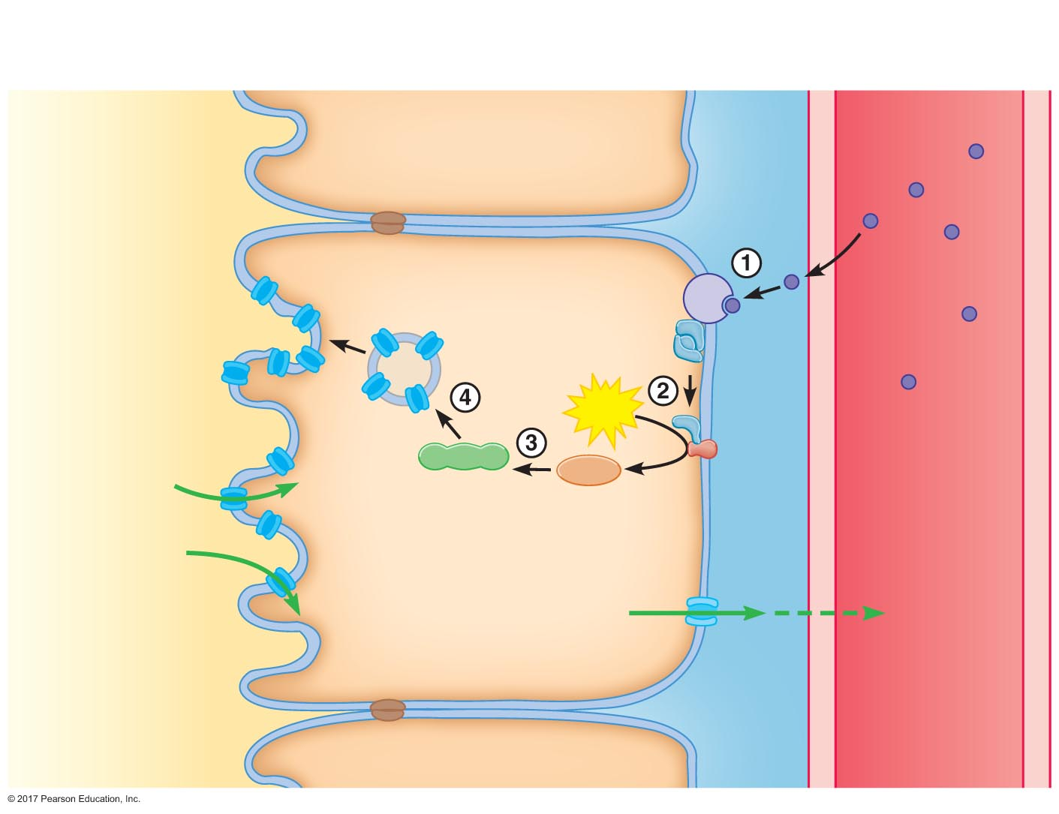
Figure 19.11 Effects of ADH on principal cells lining the late distal tubules and collecting ducts.
Slide 1
Principal cell lining late distal
tubule or collecting duct
Basolateral
membrane
Peritubular
ﬂuid
Peritubular
capillary
Tubular ﬂuid
Plasma
Apical
membrane
ADH
ADH
receptor
G protein
Aquaporin-2
ATP
H₂O
Protein
kinase
A
cAMP
H₂O
Adenylate
cyclase
H₂O
Aquaporin-3

Slide 48
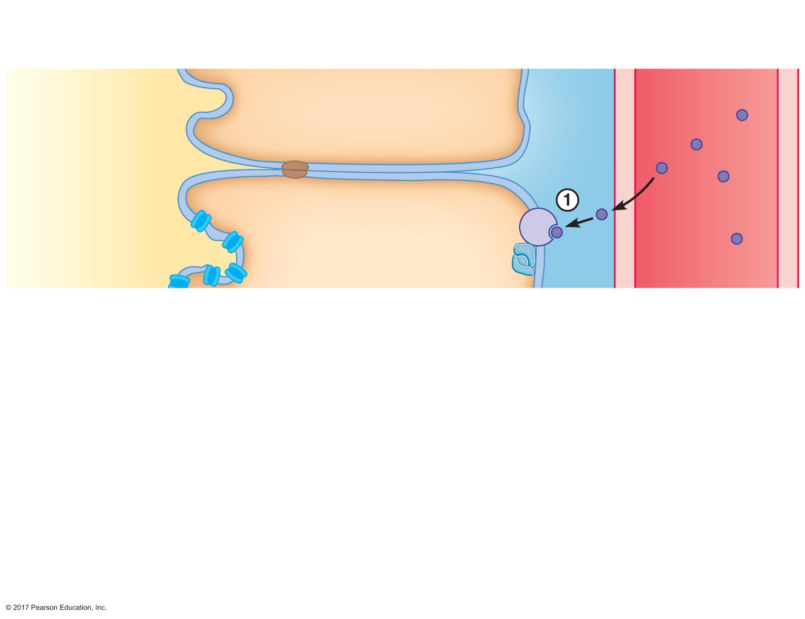
Figure 19.11 Effects of ADH on principal cells lining the late distal tubules and collecting ducts.
Slide 2
Principal cell lining late distal
tubule or collecting duct
Basolateral
membrane
Peritubular
ﬂuid
Peritubular
capillary
Tubular ﬂuid
Plasma
Apical
membrane
ADH
ADH
receptor
G protein

Slide 49
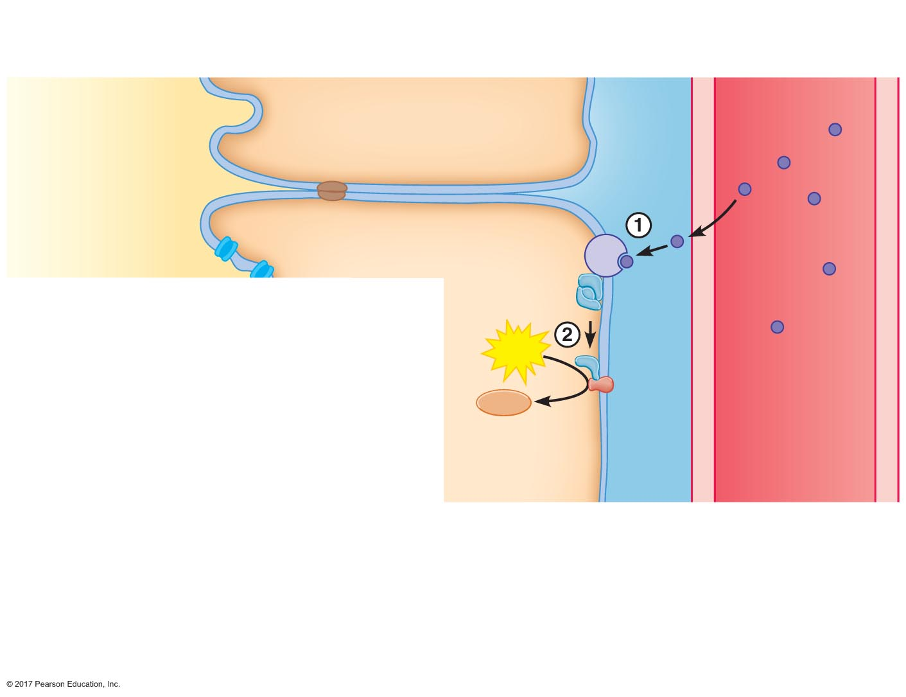
Figure 19.11 Effects of ADH on principal cells lining the late distal tubules and collecting ducts.
Slide 3
Principal cell lining late distal
tubule or collecting duct
Basolateral
membrane
Peritubular
ﬂuid
Peritubular
capillary
Tubular ﬂuid
Plasma
Apical
membrane
ADH
ADH
receptor
G protein
ATP
cAMP
Adenylate
cyclase

Slide 50
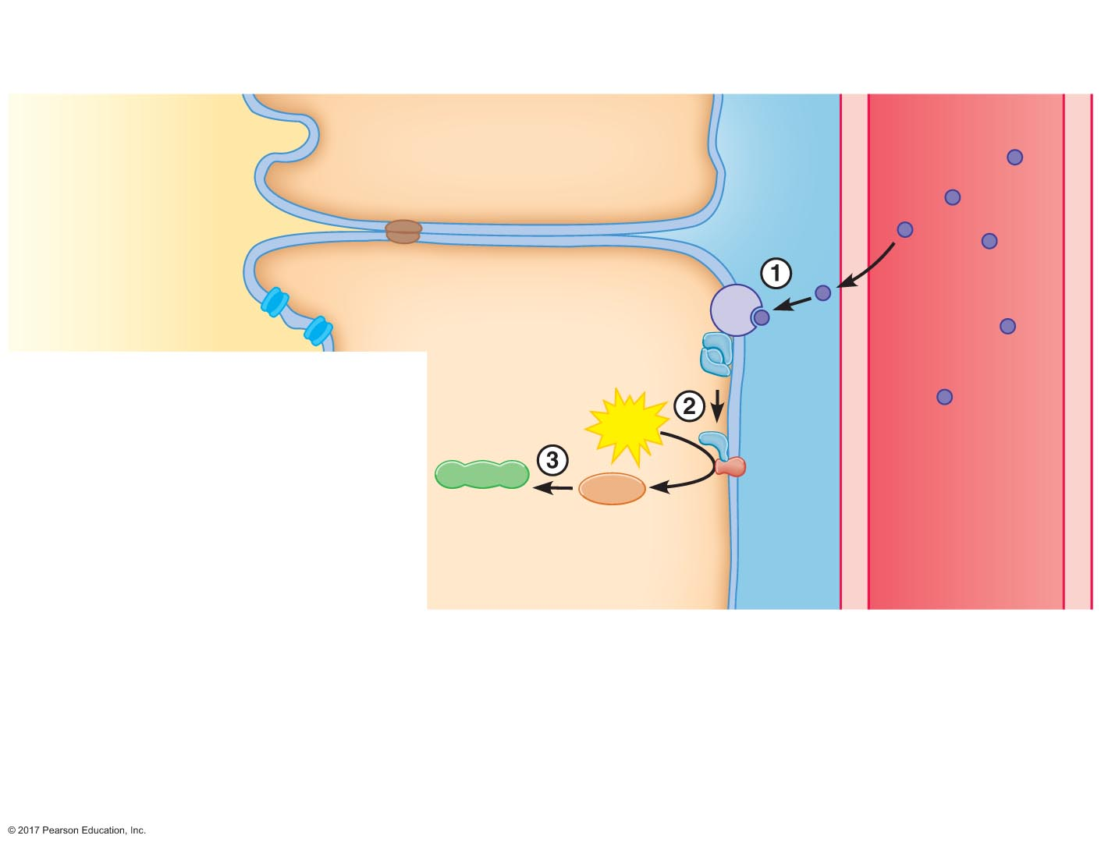
Figure 19.11 Effects of ADH on principal cells lining the late distal tubules and collecting ducts.
Slide 4
Principal cell lining late distal
tubule or collecting duct
Basolateral
membrane
Peritubular
ﬂuid
Peritubular
capillary
Tubular ﬂuid
Plasma
Apical
membrane
ADH
ADH
receptor
G protein
ATP
Protein
kinase
A
cAMP
Adenylate
cyclase

Slide 51
Figure 19.11 Effects of ADH on principal cells lining the late distal tubules and collecting ducts.
Slide 5
Principal cell lining late distal
tubule or collecting duct
Basolateral
membrane
Peritubular
ﬂuid
Peritubular
capillary
Tubular ﬂuid
Plasma
Apical
membrane
ADH
ADH
receptor
G protein
Aquaporin-2
ATP
H₂O
Protein
kinase
A
cAMP
H₂O
Adenylate
cyclase
H₂O
Aquaporin-3

Slide 52
Role of the Medullary Osmotic Gradient in Water Reabsorption in the Distal Tubule and Collecting Duct
Regulation of ADH secretion
Released from terminals in the posterior pituitary from cell bodies originating in the hypothalamus
Osmoreceptors in the organum vasculosum of laminae terminalis (OVLT) sense osmolarity
OVLT is not surrounded by the blood-brain barrier
ADH is also affected by baroreceptors detecting blood volume and pressure
↓ baroreceptor activity = ↑ ADH secretion

Slide 53
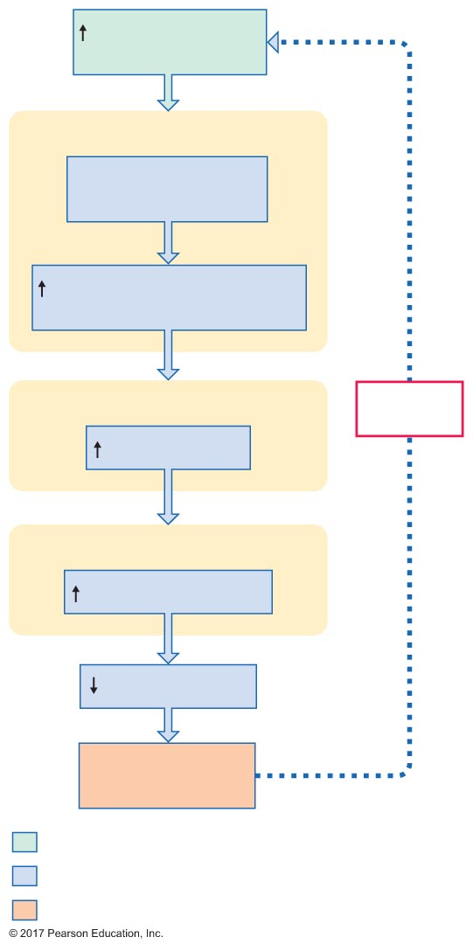
Figure 19.12 Pathway for extracellular fluid osmolarity and ADH secretion to interact.
Slide 1
Osmolarity of
extracellular ﬂuid
Hypothalamus
Osmoreceptors
detect and respond
Activity of neurosecretory
cells in hypothalamus
Posterior pituitary
Negative
feedback
ADH secretion
Kidneys
Water reabsorption
Water excretion
Conservation of
body water
Initial stimulus
Physiological response
Result

Slide 54
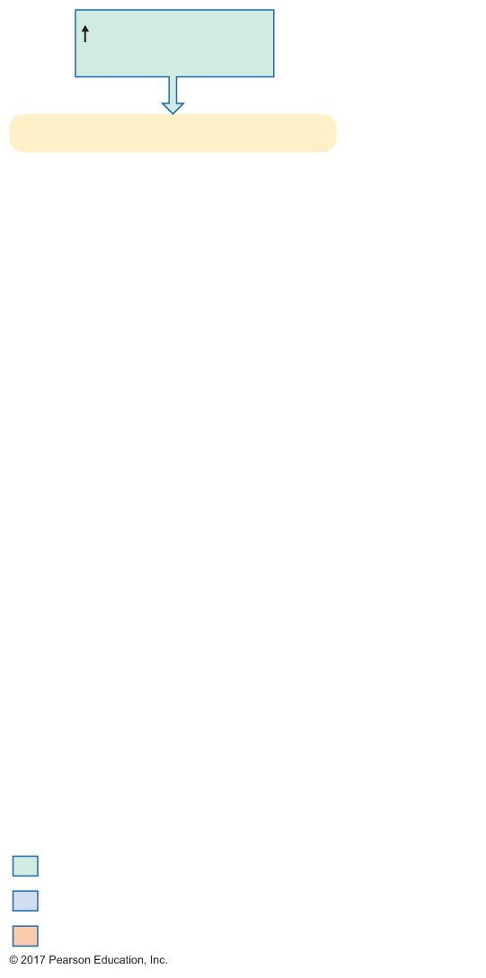
Figure 19.12 Pathway for extracellular fluid osmolarity and ADH secretion to interact.
Slide 2
Osmolarity of
extracellular ﬂuid
Hypothalamus
Initial stimulus
Physiological response
Result

Slide 55
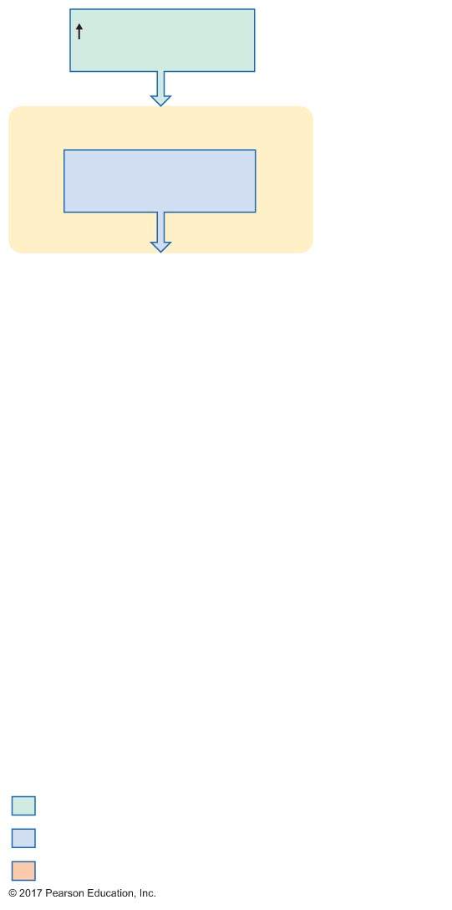
Figure 19.12 Pathway for extracellular fluid osmolarity and ADH secretion to interact.
Slide 3
Osmolarity of
extracellular ﬂuid
Hypothalamus
Osmoreceptors
detect and respond
Initial stimulus
Physiological response
Result

Slide 56
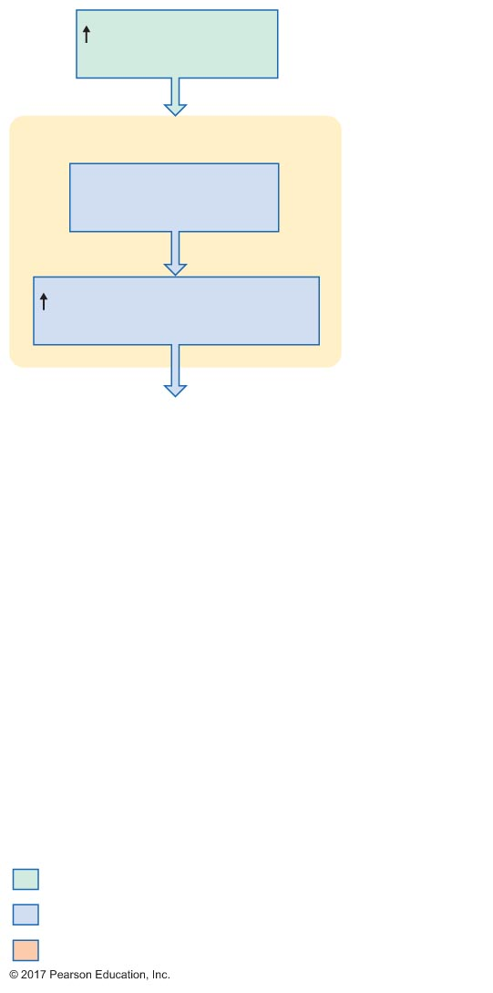
Figure 19.12 Pathway for extracellular fluid osmolarity and ADH secretion to interact.
Slide 4
Osmolarity of
extracellular ﬂuid
Hypothalamus
Osmoreceptors
detect and respond
Activity of neurosecretory
cells in hypothalamus
Initial stimulus
Physiological response
Result

Slide 57
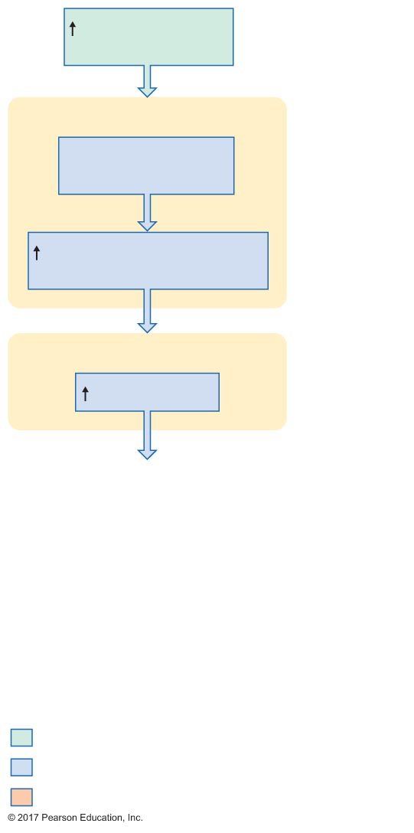
Figure 19.12 Pathway for extracellular fluid osmolarity and ADH secretion to interact.
Slide 5
Osmolarity of
extracellular ﬂuid
Hypothalamus
Osmoreceptors
detect and respond
Activity of neurosecretory
cells in hypothalamus
Posterior pituitary
ADH secretion
Initial stimulus
Physiological response
Result

Slide 58
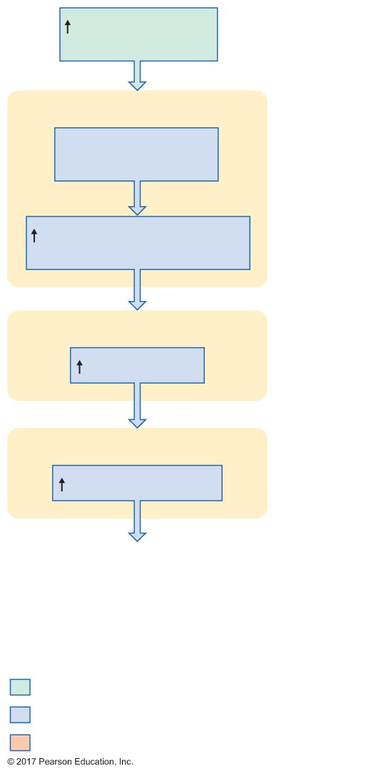
Figure 19.12 Pathway for extracellular fluid osmolarity and ADH secretion to interact.
Slide 6
Osmolarity of
extracellular ﬂuid
Hypothalamus
Osmoreceptors
detect and respond
Activity of neurosecretory
cells in hypothalamus
Posterior pituitary
ADH secretion
Kidneys
Water reabsorption
Initial stimulus
Physiological response
Result

Slide 59
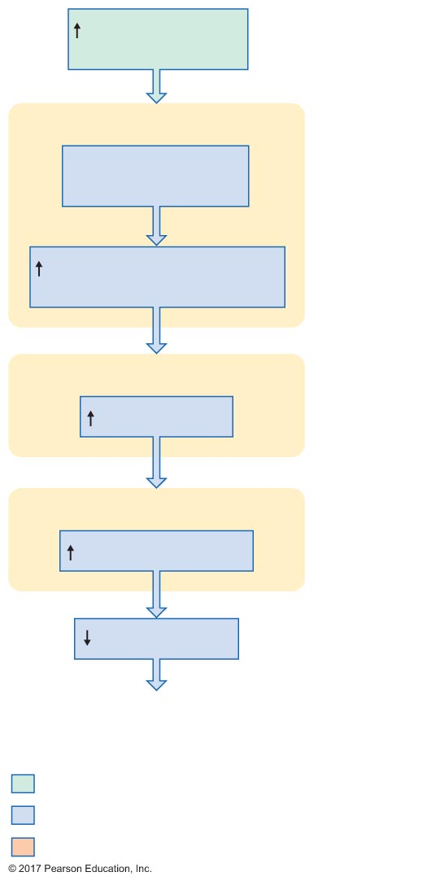
Figure 19.12 Pathway for extracellular fluid osmolarity and ADH secretion to interact.
Slide 7
Osmolarity of
extracellular ﬂuid
Hypothalamus
Osmoreceptors
detect and respond
Activity of neurosecretory
cells in hypothalamus
Posterior pituitary
ADH secretion
Kidneys
Water reabsorption
Water excretion
Initial stimulus
Physiological response
Result

Slide 60
Figure 19.12 Pathway for extracellular fluid osmolarity and ADH secretion to interact.
Slide 8
Osmolarity of
extracellular ﬂuid
Hypothalamus
Osmoreceptors
detect and respond
Activity of neurosecretory
cells in hypothalamus
Posterior pituitary
Negative
feedback
ADH secretion
Kidneys
Water reabsorption
Water excretion
Conservation of
body water
Initial stimulus
Physiological response
Result

Slide 61
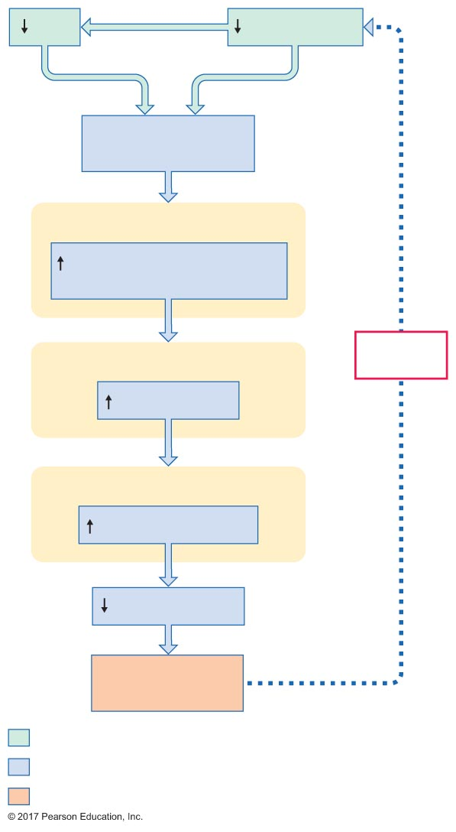
Figure 19.13 Effects of arterial and cardiac baroreceptors on ADH.
Slide 1
MAP
Blood volume
Baroreceptors
detect and respond
Hypothalamus
Activity of neurosecretory
cells in hypothalamus
Posterior pituitary
Negative
feedback
ADH secretion
Kidneys
Water reabsorption
Water excretion
Conservation of
blood volume
Initial stimulus
Physiological response
Result

Slide 62
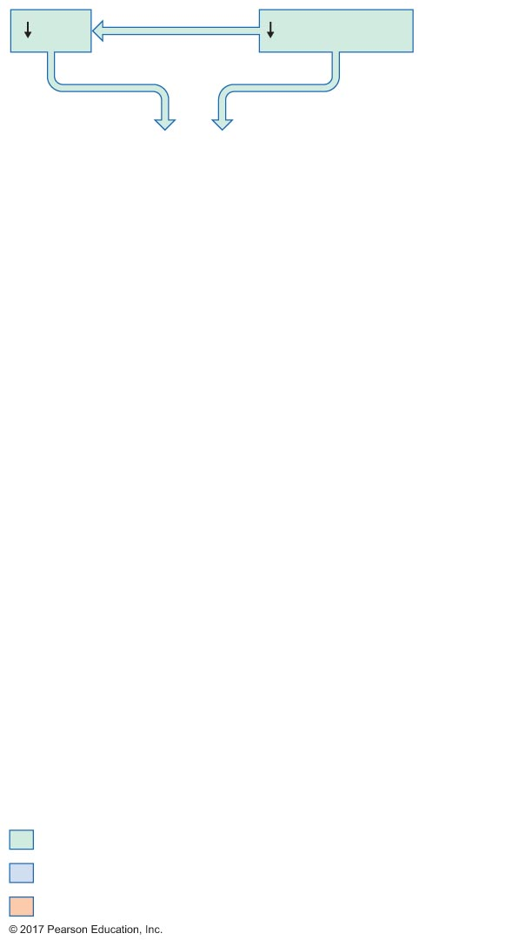
Figure 19.13 Effects of arterial and cardiac baroreceptors on ADH.
Slide 2
MAP
Blood volume
Initial stimulus
Physiological response
Result

Slide 63
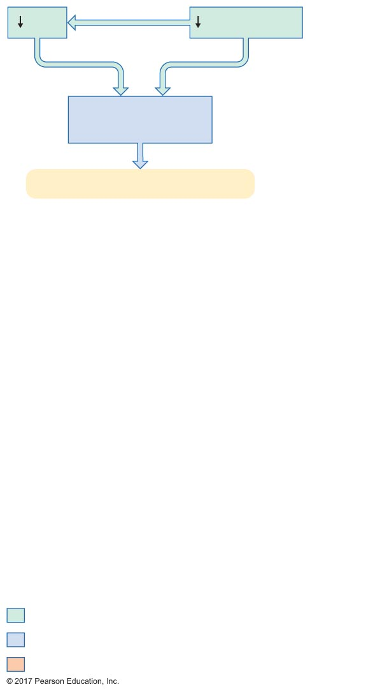
Figure 19.13 Effects of arterial and cardiac baroreceptors on ADH.
Slide 3
MAP
Blood volume
Baroreceptors
detect and respond
Hypothalamus
Initial stimulus
Physiological response
Result

Slide 64
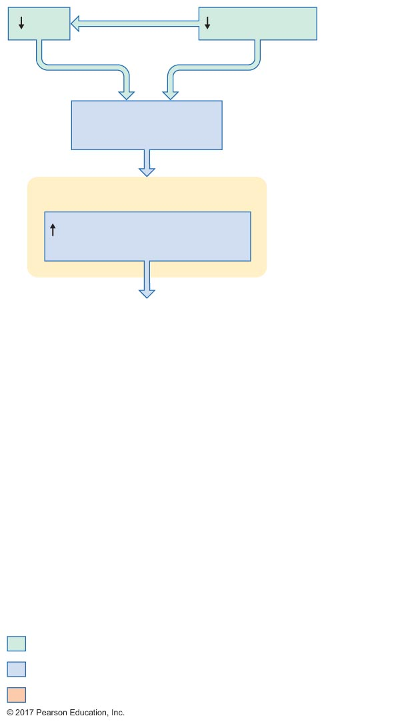
Figure 19.13 Effects of arterial and cardiac baroreceptors on ADH.
Slide 4
MAP
Blood volume
Baroreceptors
detect and respond
Hypothalamus
Activity of neurosecretory
cells in hypothalamus
Initial stimulus
Physiological response
Result

Slide 65
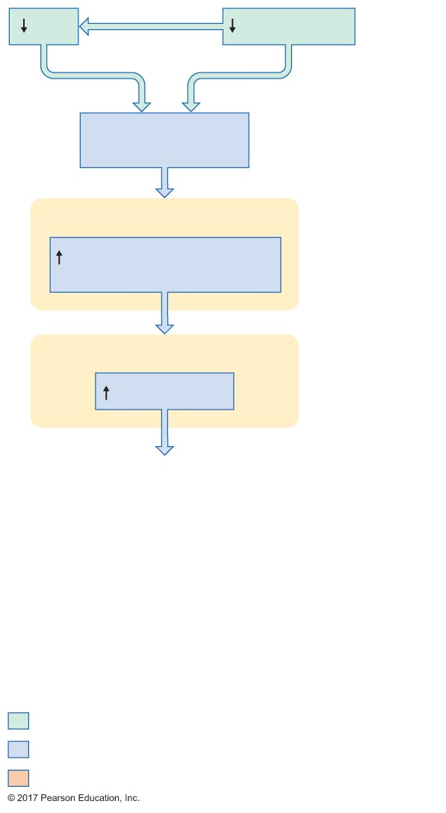
Figure 19.13 Effects of arterial and cardiac baroreceptors on ADH.
Slide 5
MAP
Blood volume
Baroreceptors
detect and respond
Hypothalamus
Activity of neurosecretory
cells in hypothalamus
Posterior pituitary
ADH secretion
Initial stimulus
Physiological response
Result

Slide 66
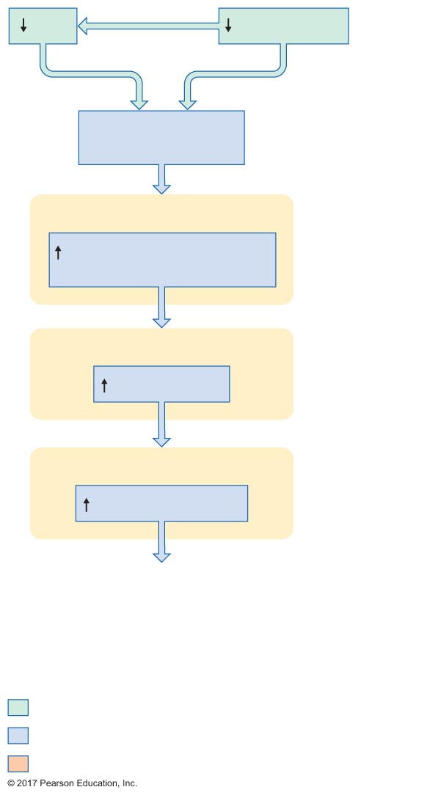
Figure 19.13 Effects of arterial and cardiac baroreceptors on ADH.
Slide 6
MAP
Blood volume
Baroreceptors
detect and respond
Hypothalamus
Activity of neurosecretory
cells in hypothalamus
Posterior pituitary
ADH secretion
Kidneys
Water reabsorption
Initial stimulus
Physiological response
Result

Slide 67
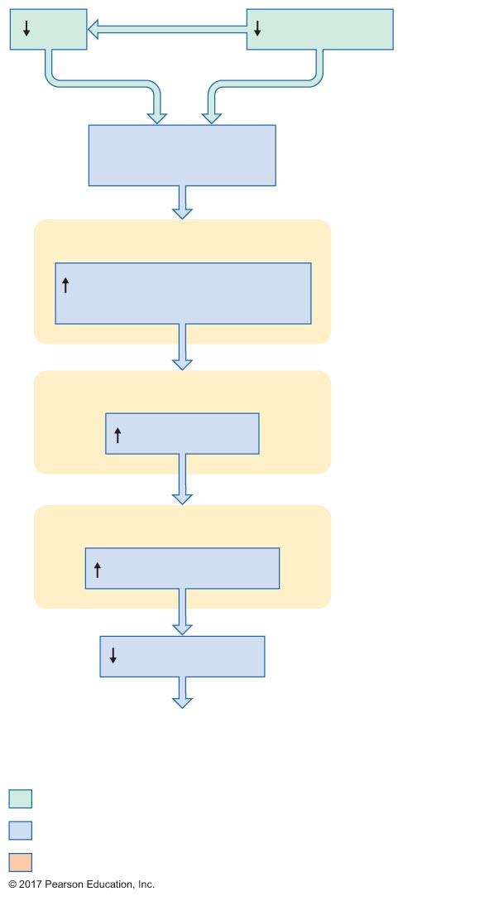
Figure 19.13 Effects of arterial and cardiac baroreceptors on ADH.
Slide 7
MAP
Blood volume
Baroreceptors
detect and respond
Hypothalamus
Activity of neurosecretory
cells in hypothalamus
Posterior pituitary
ADH secretion
Kidneys
Water reabsorption
Water excretion
Initial stimulus
Physiological response
Result

Slide 68
Figure 19.13 Effects of arterial and cardiac baroreceptors on ADH.
Slide 8
MAP
Blood volume
Baroreceptors
detect and respond
Hypothalamus
Activity of neurosecretory
cells in hypothalamus
Posterior pituitary
Negative
feedback
ADH secretion
Kidneys
Water reabsorption
Water excretion
Conservation of
blood volume
Initial stimulus
Physiological response
Result

Slide 69
Role of the Medullary Osmotic Gradient in Water Reabsorption in the Distal Tubule and Collecting Duct
Regulating water excretion by changing GFR
GFR is normally autoregulated
If blood pressure drops to less than 80 mm Hg
Decrease in GFR
Decrease in water filtered
Decrease in water excretion
If blood pressure increases to more than 180 mm Hg
Increase in GFR
Increase in water filtered
Increase in water excretion
Occurs only in pathological circumstances

